Slide 1
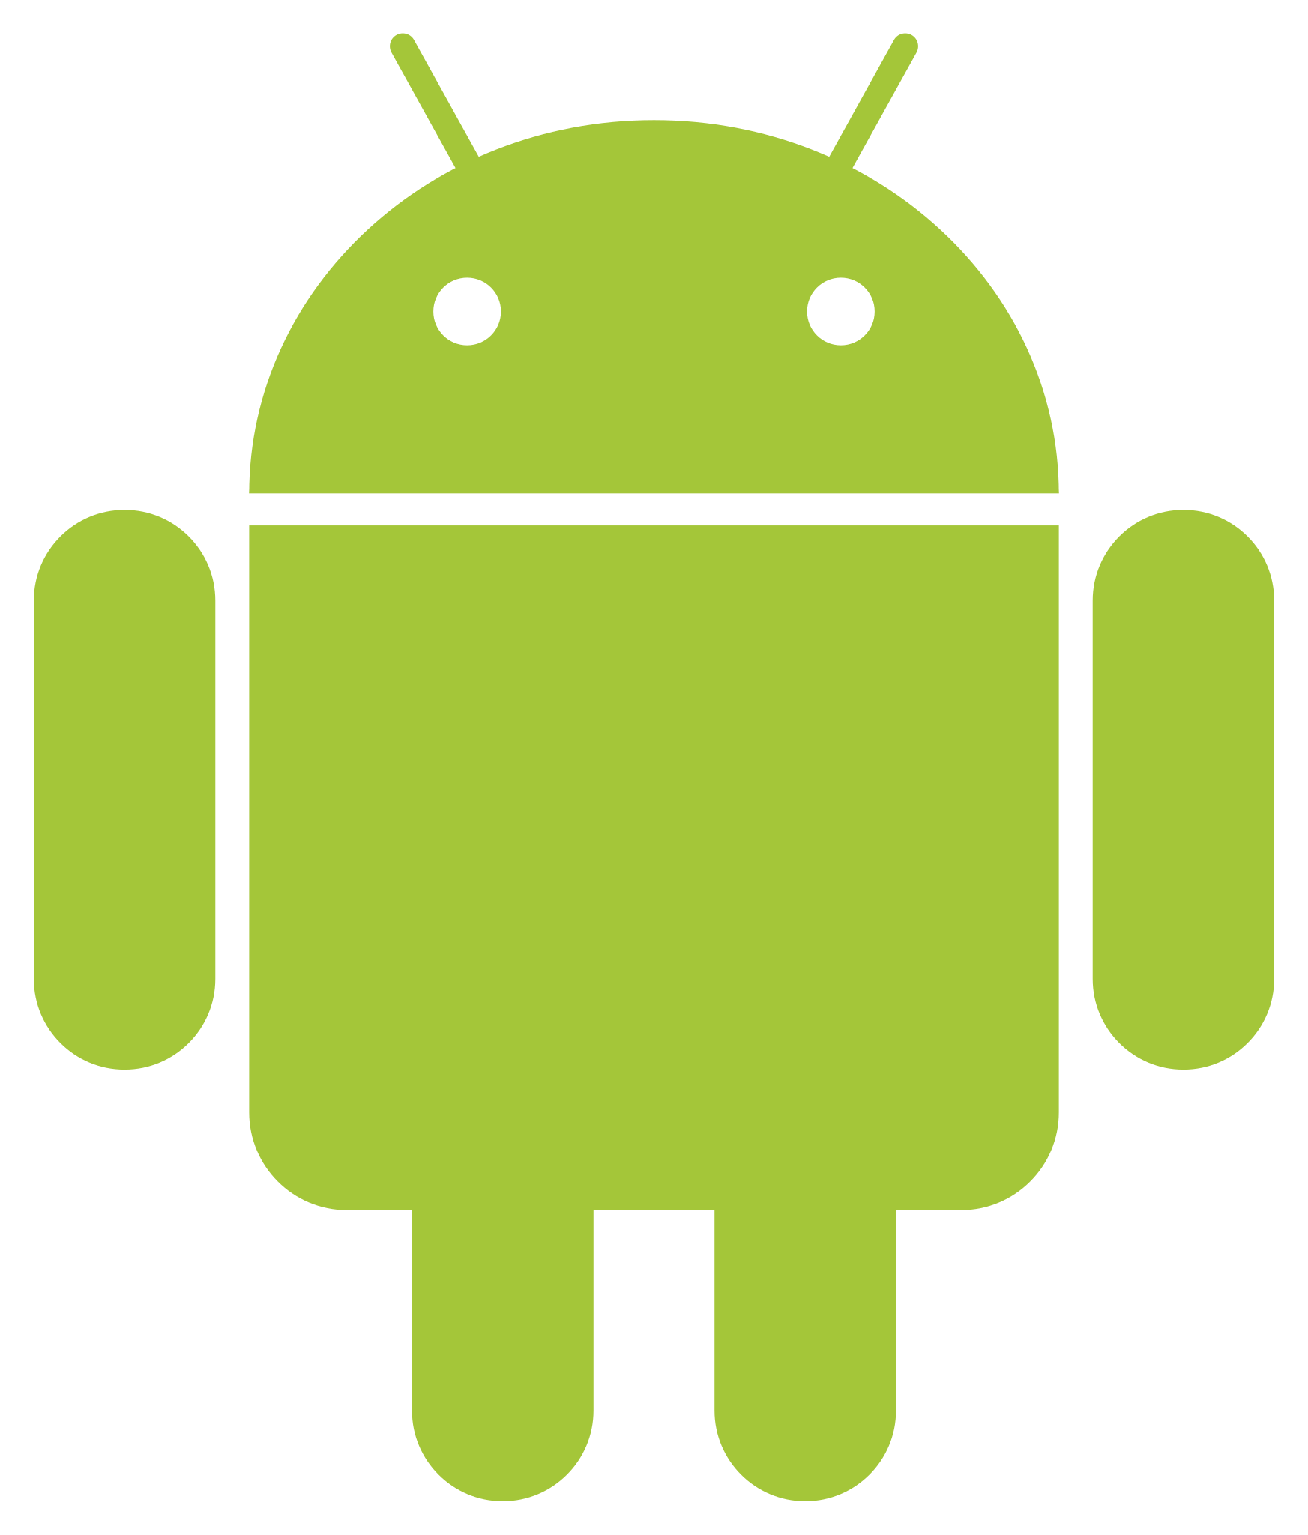
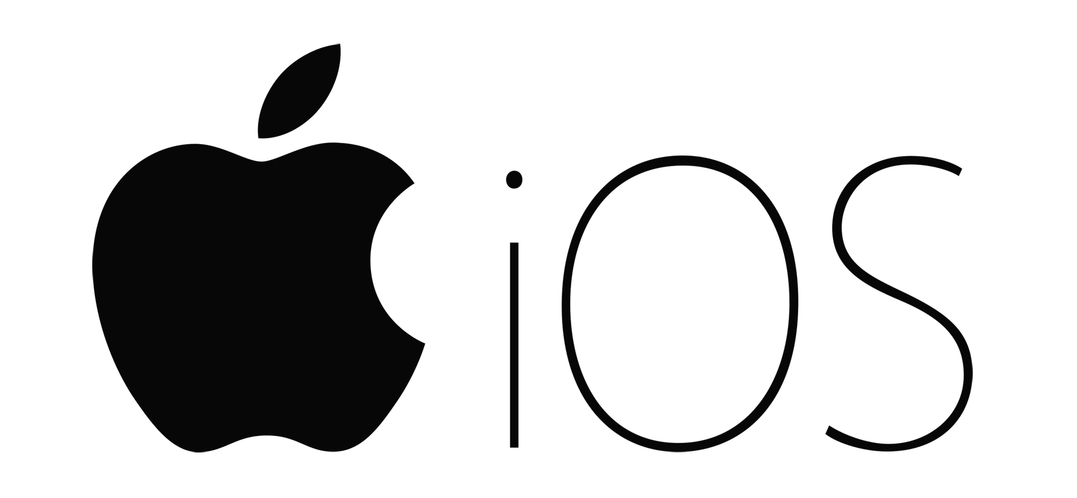
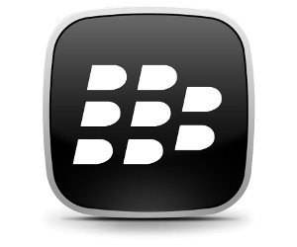
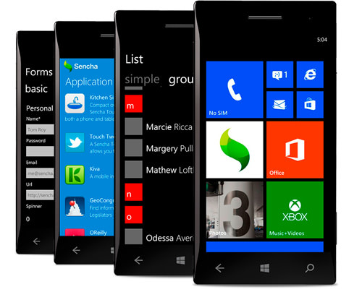
MOBILE OPERATING SYSTEM
By:
Pallavi naik
Computer science

Slide 2
CONTENTS
What is mobile operating system
History of mobile operating system
Different types of mobile operating system
Features of mobile operating system
conclusion

Slide 3
What is mobile operating system
An operating system which controls mobile devices is called mobile operating system. They are simple and deal with wireless versions of broadband and local connectivity.
A mobile operating system (OS) is software that allows smartphones, tablet PCs and other devices to run applications and programs.

Slide 4
History of mobile operating system
Android began in 2003 as a project of the American technology company Android Inc., to develop an operating system for digital cameras.
In 2004 the project changed to become an operating system for smartphones. Android Inc., was bought by the American search engine company Google Inc., in 2005.

Slide 5
Different types of mobile OS
There are many mobile operating systems. The following demonstrate the most important ones:
Symbian
Android
iOS (iPhone OS)
Window Phone
RIM BlackBerry

Slide 6
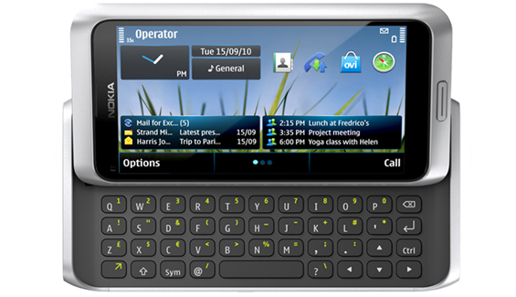
SYMBIAN
Symbian operating system is a mobile operating system that provides a high-level of integration with communication.
less communications It combines middleware of wire and personal information management (PIM) functionality.
The Symbian operating system was developed by Symbian Ltd in 1998 for the use of mobile phones.
Nokia was the first company to release Symbian OS on its mobile phone at that time.
Symbian OS contained a browser, messaging, multimedia, communication protocol, mobile telephony, data synchronization, security, application environment, multi-tasking, robustness, flexible.

Slide 7
ANDROID
The Android operating system is a mobile operating system that was developed by Google (GOOGL​) to be primarily used for touchscreen devices, cell phones, and tablets.
The Android operating system is the most popular operating system today.
It is a mobile OS based on the Linux Kernel and open-source software.
The android operating system was developed by Google. The first Android device was launched in 2008.

Slide 8
iOS(iPhone OS)
It was developed by Apple Inc. and originally released in 2007 for iPhone and iPod touch.
It is based on the Mach kernel. Mac OS X has a primitive multitasking environment.
It supports real time behavior and a very secure operating system.
In June 2010,Apple rebranded iPhone OS as “iOS”.
It has second ,largest installed base worldwide on smartphones behind Android.

Slide 9
Windows phone
WP is a series of proprietary and closed source mobile operating system developed by Microsoft.
It is designed for mobile devices and based on Windows 32-bit.
It runs on pocket PCs, Smartphones and portable media centers.
It provides ultimate interoperability.
It has third largest installed base on smartphones behind Android and iOS.

Slide 10
RIM BlackBerry
It is a proprietary operating system and it is developed by Research in Motion (RIM) for their Blackberry handhelds.
It supports multitasking.
Its operating system is designed for use with input devices like track wheel, track ball and track pad.
It has strong security controls. And it provides good security for data.

Slide 11
COMPARISON TABLE
Comparison table: Major Mobile Operating Systems
Features | Android | iOS | Windows Phone | Symbian OS | Blackberry OS
Applications | 13,00,000+ applications available | 12,50,000 + applications available | 4,00,000+ applications available | Open platform so many 3rd party apps can be developed | 260,000+ applications available
Widgets | Yes | No (Except in notification center) | Expandable live titles | Yes | Yes
Expandable Storage | Yes | No | Yes | Yes | Yes
Customization | Yes | Limited extent | Limited extent | Yes | No
Availability | Many popular brands HTC, Samsung, Sony, LG etc | iPod Touch, iPhone, iPad, Apple TV | Nokia, HTC, Samsung | Nokia (some models) | Blackberry devices only
Limitations | •Requires an active internet connection •Quick battery drains due to background processing | •No widget support for iOS •Limited device use as it runs only on Apple device | •Lack of availability of applications •No updates •No more push notifications | •No virtual memory •Easily affected by virus | •Very less applications available •Bluetooth sharing hard and difficult to configure •Delayed restart due to security check •Low processing speed

Slide 12
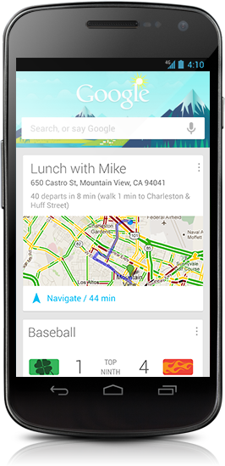
Features of mobile operating system :
Google Now
Google Now is an intelligent personal assistant developed by google
It was first included in Android 4.1(“Jelly Bean”),which launched on July 9,2012

Slide 13
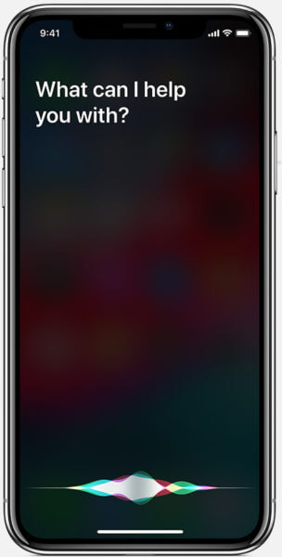
SIRI
Siri is a part of Apple Inc.’s iOS which works as a personal assistant and knowledge navigator
Siri has been an integral part of iOS since IOS 5 and was introduced as a features of the iPhone 45 on October 14,2011

Slide 14
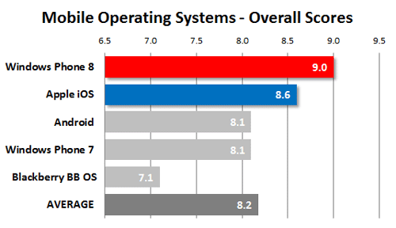

Slide 15
CONCLUSION
A mobile operating system (OS) is software that runs on a mobile device.
It makes it possible for apps to run on smartphones etc. Some types of OS include Android, Blackberry, Apple iOS, Symbian, Microsoft Windows Mobile OS.

Slide 16
Thank you

